Slide 1



Lecture 1c
Backpropagation
Master in Big Data Solutions 2020-2021 - Artificial Intelligence
Xavier Giró
xavier.giro@bts.tech

Slide 2




Acknowledgements
Kevin McGuinness
kevin.mcguinness@dcu.ie
Research Fellow
Insight Centre for Data Analytics
Dublin City University
Elisa Sayrol
elisa.sayrol@upc.edu
Associate Professor
ETSETB TelecomBCN
Universitat Politècnica de Catalunya

Slide 3


Study case: House price prediction
Consider a linear regressor...
1
x₁
b
w₁
x₂
ŷ = {-∞, ∞}
w₂
x₃
w₃
...with actually one single parameter w :
x
w
ŷ = {-∞, ∞}

Slide 4
Study case: House price prediction
Question: How could we compare the quality of the predicted prices ?

Slide 5

Study case: House price prediction
Question: How could we compare the quality of the predicted prices ?
The gap between the predicted price (ŷ) and one actually paid (y) is the loss function.
For example, a popular loss function is the Euclidean distance:
also referred as “L2 distance” or “Square Error”.

Slide 6
Study case: House price prediction
Question: What is the shape of the loss function with respect to w ?

Slide 7
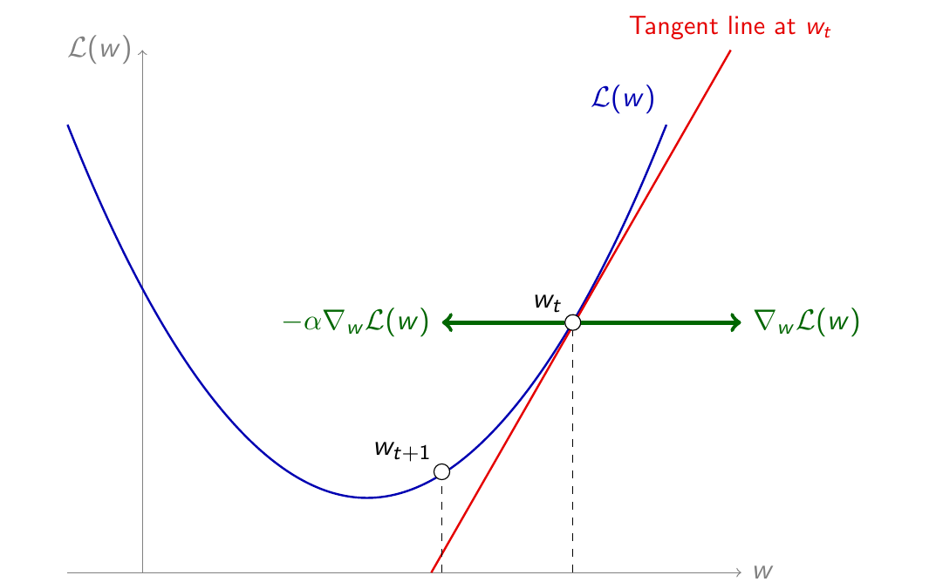
Study case: House price prediction
Question: What is the shape of the loss function with respect to w ?
L_{w}

Slide 8
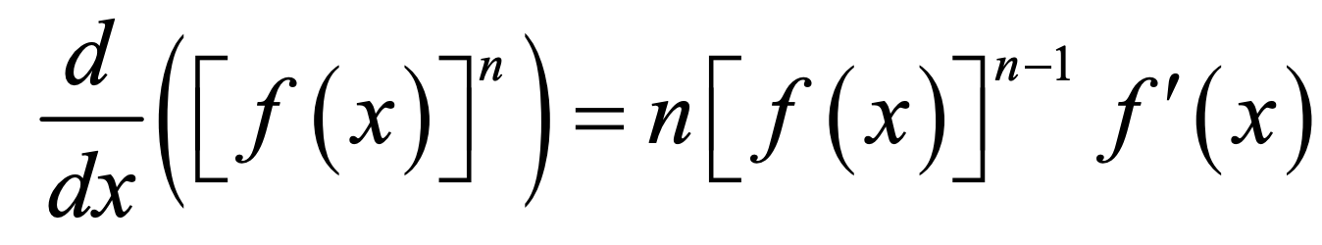
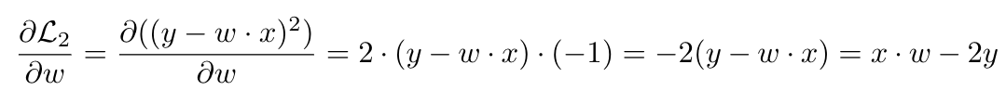
Study case: House price prediction
Question: What is the shape of the loss function with respect to w ?
L_{w}

Slide 9
Loss function - L(y, ŷ)
Discussion: Given a pair of training data (y, ŷ), we would like to update the current w_{t} value to a new w_{t+1} based on the loss function L_{w}.
Would you increase or decrease w_{t} ?
What operation could indicate which way to go ?
How much would you increase or decrease w_{t} ?
L_{w}

Slide 10
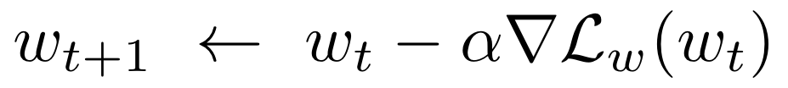
Gradient Descent (GD)
Motivation for this lecture:
if we had a way to estimate the gradient of the loss (▽L) with respect to the parameter(s), we could use gradient descent to optimize them.
L_{w}
Descend
(minus sign)
Learning
rate (LR)
Notes:
Canvia la W o la W1

Slide 11

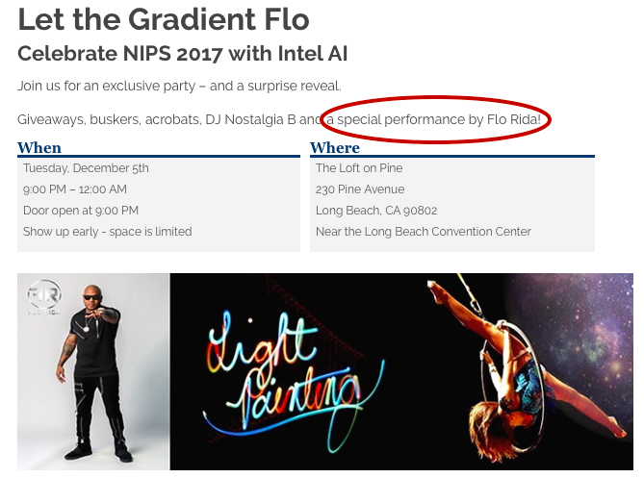
Gradient Descent (GD)
Backpropagation will allow us to compute the gradients of the loss function with respect to:
all model parameters (w & b) - final goal during training
input/intermediate data - visualization & interpretability purposes.
Gradients will “flow” from the output of the model towards the input (“back”).

Slide 12
Computational graph of a logistic regressor
1
b
Question: What is the computational graph (operations & order) of this perceptron with a sigmoid activation ?
σ
ŷ = {0, 1}
x₁
w₁
x₂
w₂

Slide 13
Computational graph of a logistic regressor
w₁
1
x
x₁
b
w₂
σ
ŷ = {0, 1}
x₁
w₁
x
x₂
x₂
w₂
Example adapted from “CS231n: Convolutional Neural Networks for Visual Recognition”, Stanford University.

Slide 14
Computational graph of a logistic regressor
w₁
1
x
x₁
b
+
w₂
σ
ŷ = {0, 1}
x₁
w₁
x
x₂
x₂
w₂
Example adapted from “CS231n: Convolutional Neural Networks for Visual Recognition”, Stanford University.

Slide 15
Computational graph of a logistic regressor
w₁
1
x
x₁
b
+
+
w₂
σ
ŷ = {0, 1}
x₁
w₁
x
x₂
x₂
w₂
b
Example adapted from “CS231n: Convolutional Neural Networks for Visual Recognition”, Stanford University.

Slide 16
Computational graph of a logistic regressor
w₁
1
x
x₁
ŷ
b
+
+
σ
w₂
σ
ŷ = {0, 1}
x₁
w₁
x
x₂
x₂
w₂
b
Example adapted from “CS231n: Convolutional Neural Networks for Visual Recognition”, Stanford University.

Slide 17







Computational graph of a logistic regressor
w₁
1
x
x₁
1
0.73
ŷ
b
+
+
σ
w₂
σ
ŷ = {0, 1}
x₁
w₁
x
x₂
x₂
w₂
b
Forward pass

Slide 18
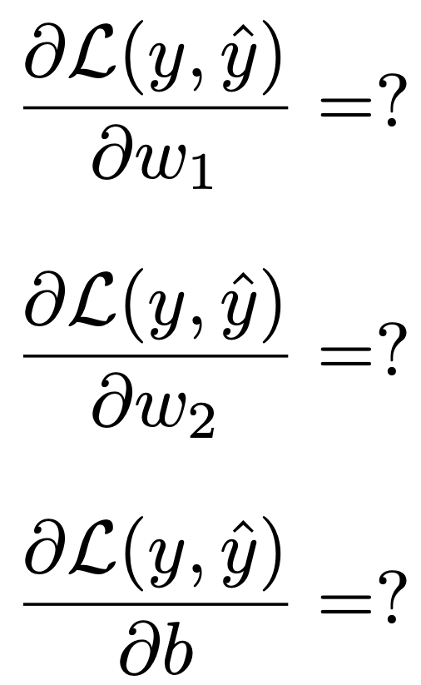
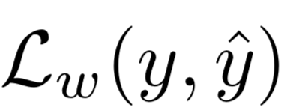
Computational graph of a perceptron
Challenge: How to compute the gradient of the loss function with respect to w₁ or w₂ ?
w₁
x
x₁
+
+
σ
ŷ
w₂
x
x₂
y
b

Slide 19
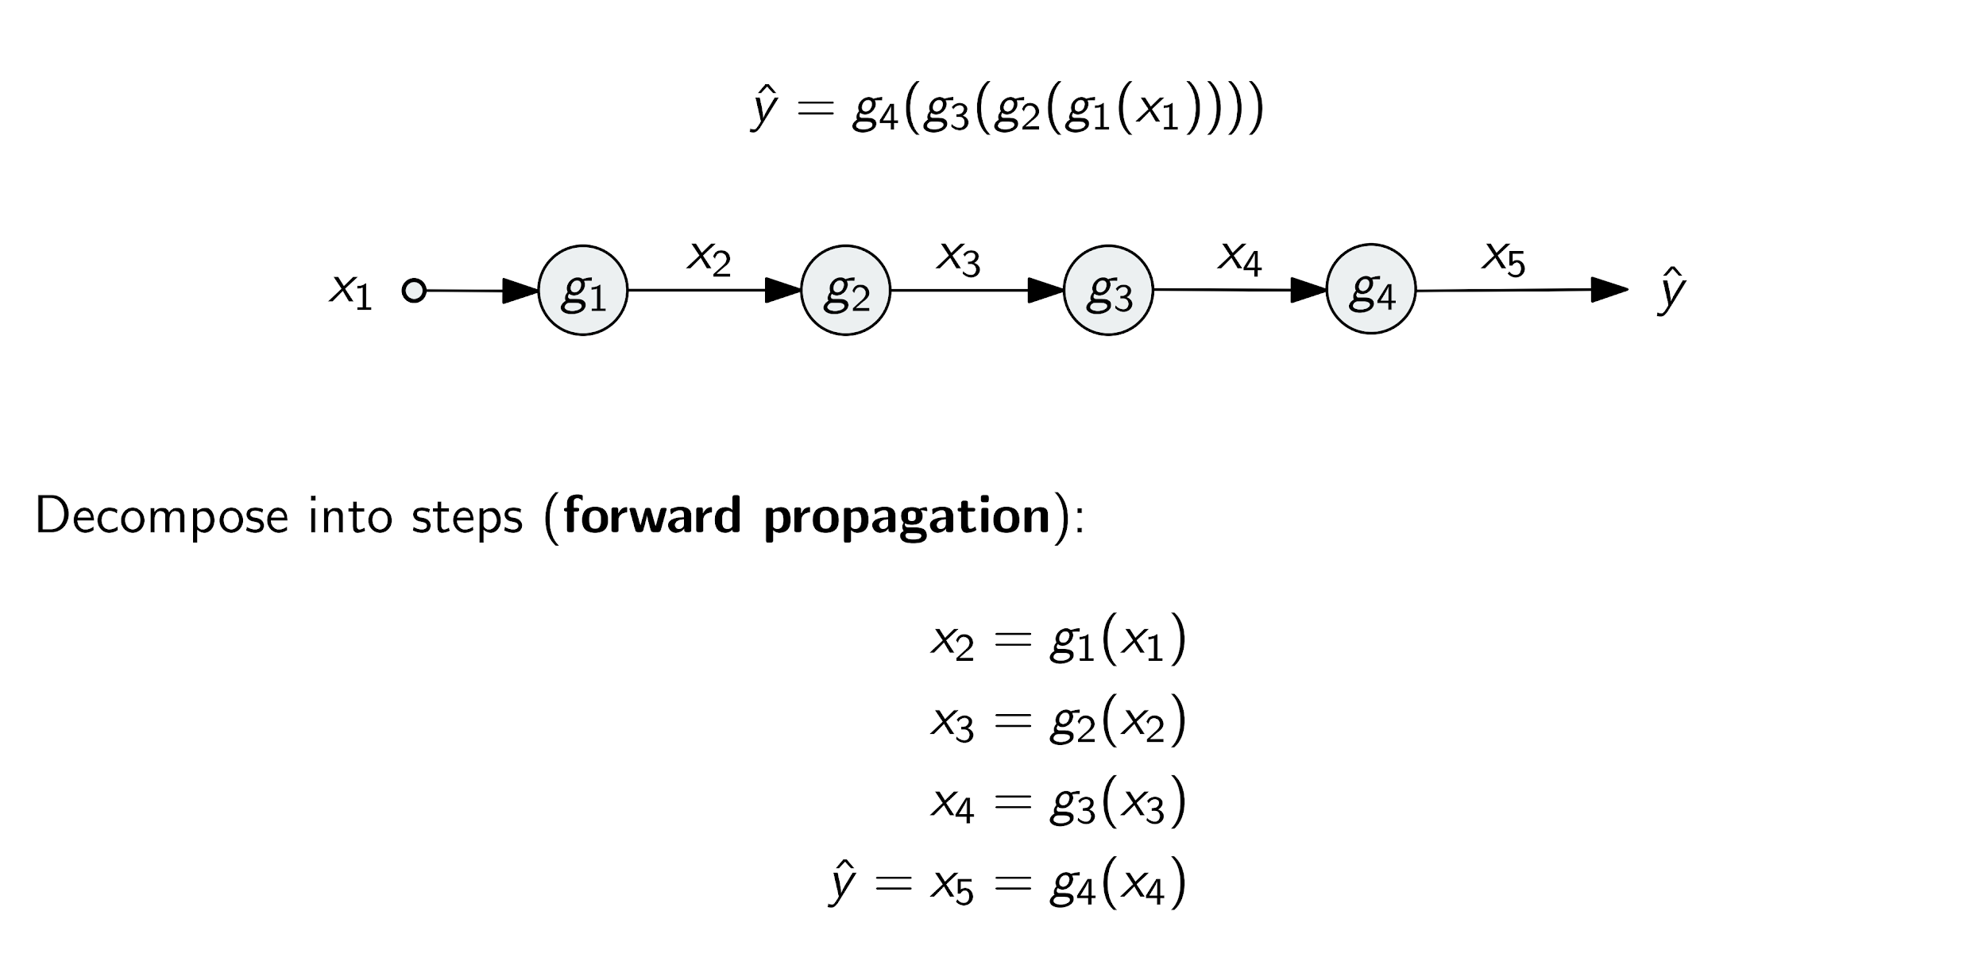
Gradients from composition (chain rule)
Forward pass

Slide 20
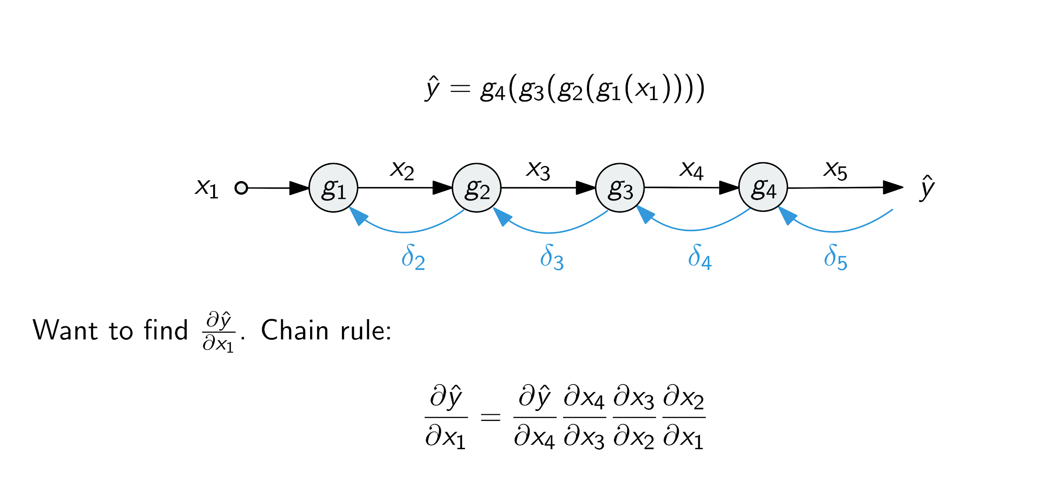
Gradients from composition (chain rule)
How does a variation (“difference”) on the input affect the prediction ?
Backward pass

Slide 21
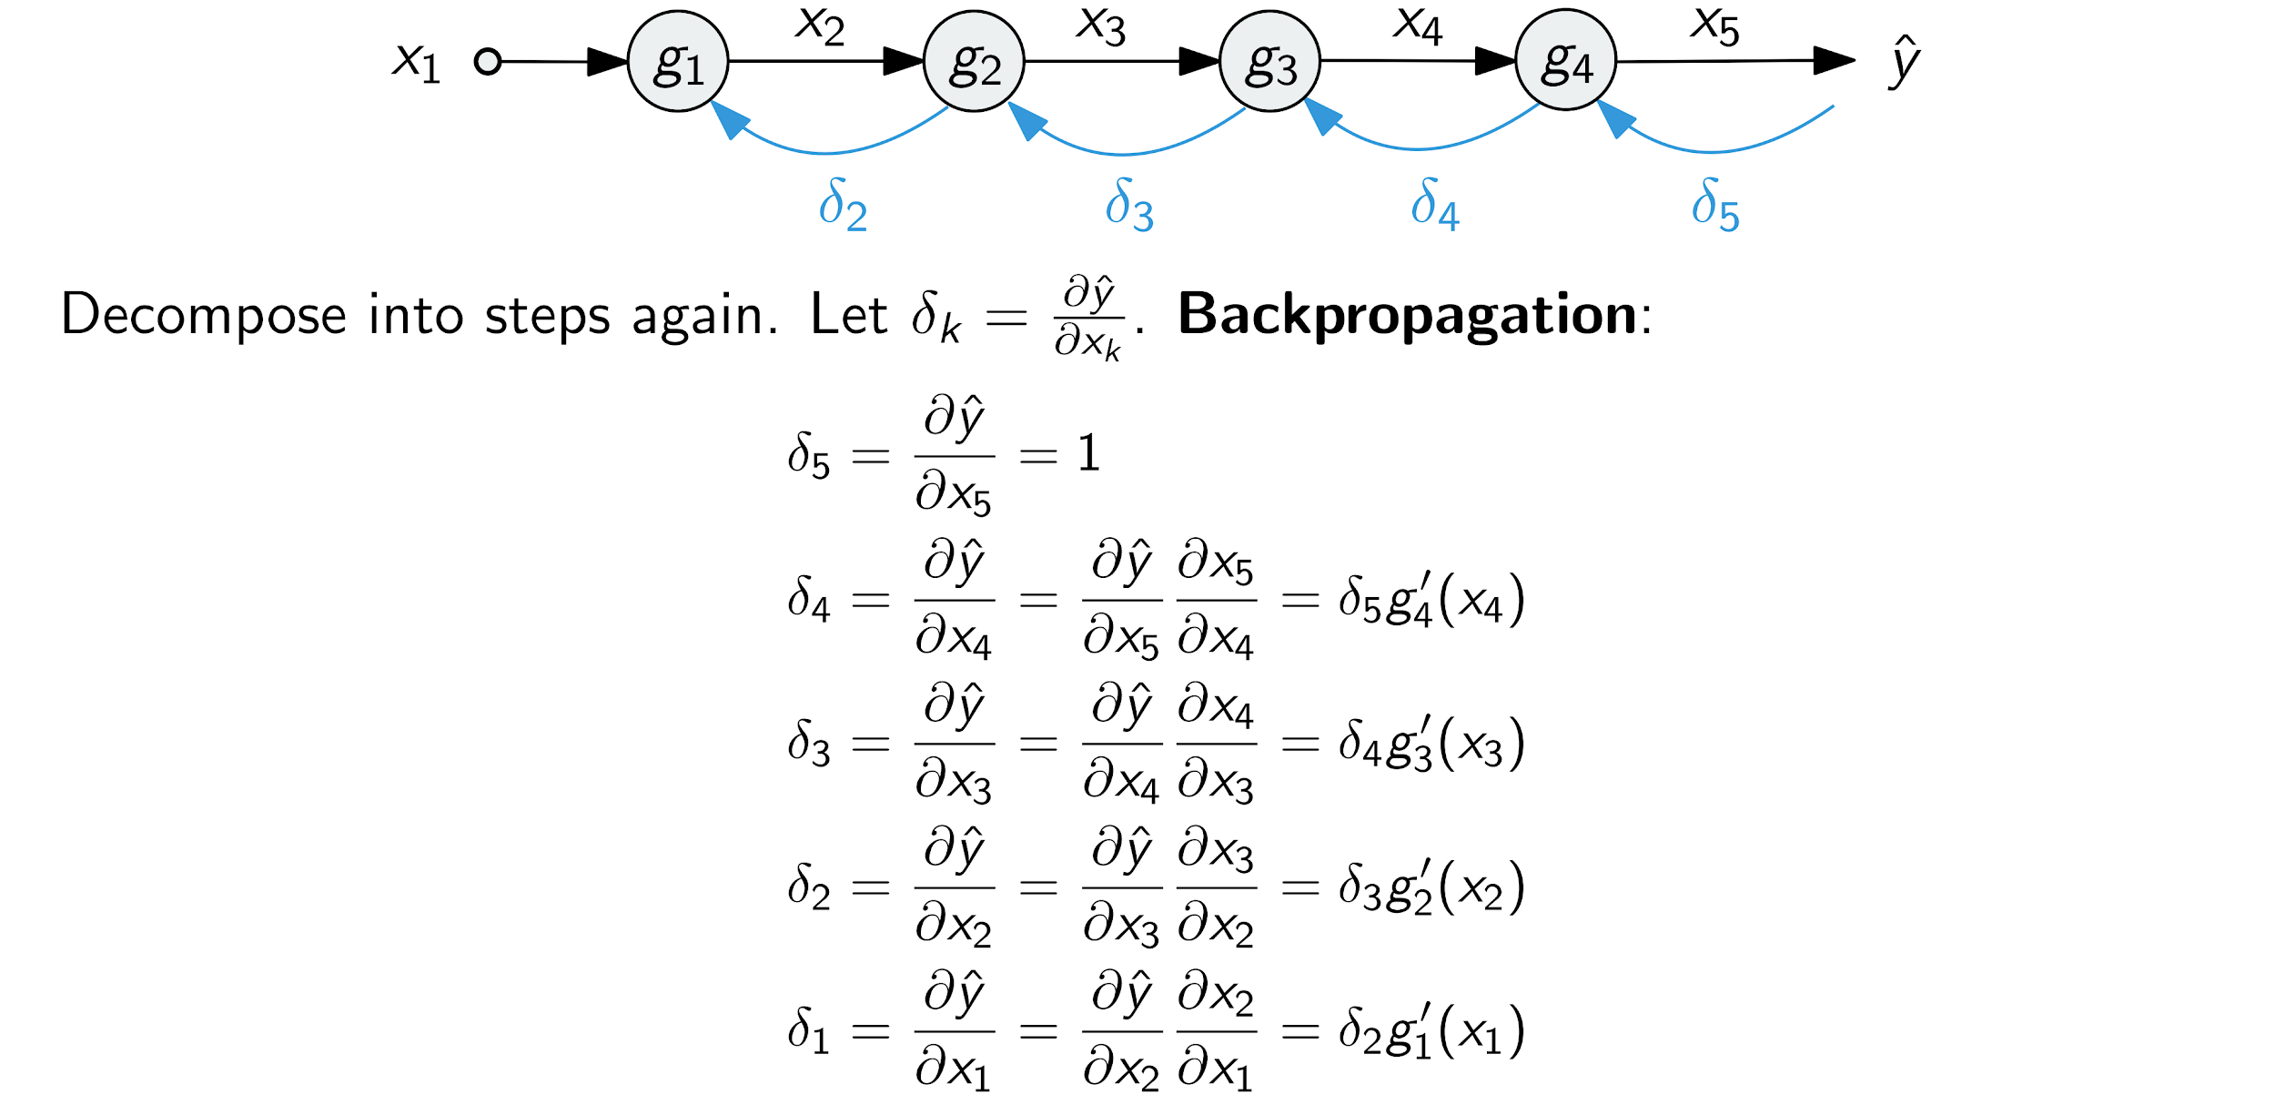
Gradients from composition (chain rule)
A variation in x₅ directly affects on ŷ with a 1:1 factor.

Slide 22
Gradients from composition (chain rule)
How does a variation on x₄ affect the predicted ŷ ?

Slide 23
Gradients from composition (chain rule)
How does a variation on x₄ affect the predicted ŷ ?
It corresponds to how a variation of x₅ affects ŷ...

Slide 24
Gradients from composition (chain rule)
How does a variation on x₄ affect the predicted ŷ ?
...multiplied by how a variation near the input x₄ affects the output g₄(x₄).
It corresponds to how a variation of x₅ affects ŷ ...

Slide 25
Gradients from composition (chain rule)
The same reasoning can be iteratively applied until reaching :
Backward pass

Slide 26
Gradients from composition (chain rule)
In order to compute , we must:
1) Find the derivative function ➝ g’_{i}(·)
2) Evaluate g’_{i}(·) at x_{i} ➝ g’_{i}(x_{i})
3) Multiply g’_{i}( x_{i} ) with the backpropagated gradient (δ_{k}).

Slide 27
Gradients from composition (chain rule)
L(y, ŷ)
When training NN, we will actually compute the derivative over the loss function, not over the predicted value ŷ.
Backward pass

Slide 28
Gradients from composition (chain rule)
Question: What are the derivatives of the function involved in the computational graph of a logistic regressor ?
SIGMOID (σ)
SUM (+)
PRODUCT (x)
w₁
x
x₁
ŷ
+
+
σ
w₂
x
x₂
b

Slide 29
Gradient backpropagation in a perceptron
We can now estimate the sensitivity of the output y with respect to each input parameter w_{i} and x_{i}.
w₁
x
x₁
1
0.73
ŷ
+
+
σ
w₂
dy/dy=1
x
x₂
b
Backward pass
Example extracted from Andrej Karpathy’s notes for CS231n from Stanford University.

Slide 30
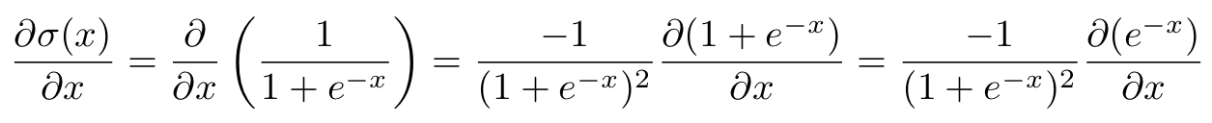
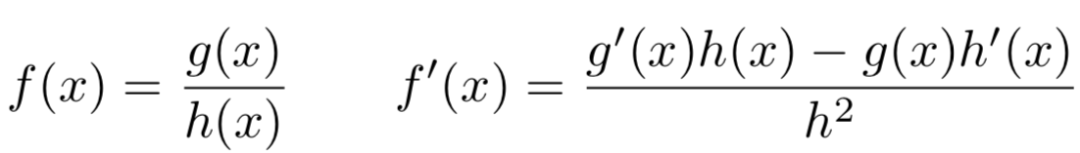
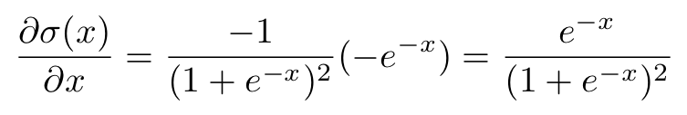
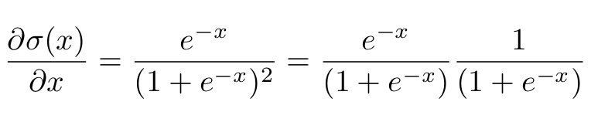
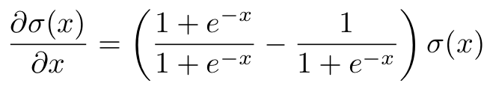
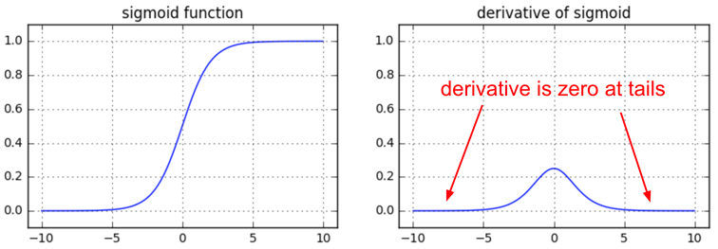
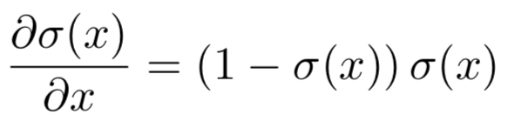
Gradient weights for sigmoid σ
(*)
(*)
w₁
x
...which can be re-arranged as...
x₁
ŷ
+
+
σ
w₂
x
x₂
b
Even more details: Arunava, “Derivative of the Sigmoid function” (2018)
Figure: Andrej Karpathy

Slide 31
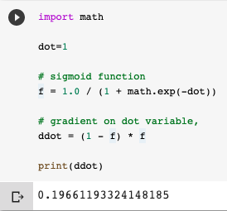
Gradient backpropagation in a logistic regressor
w₁
x
x₁
1
0.73
ŷ
+
+
σ
w₂
0,2
dŷ/dŷ=1
x
x₂
b
Backward pass
Example extracted from Andrej Karpathy’s notes for CS231n from Stanford University.

Slide 32
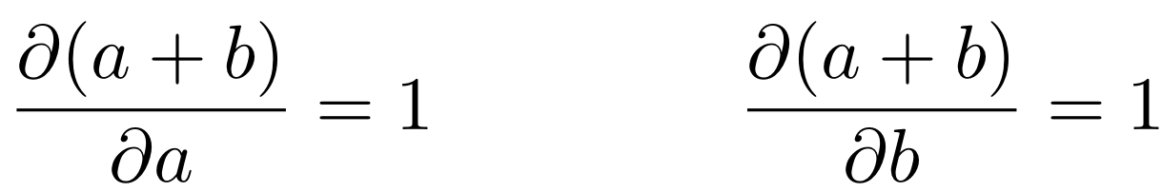
Gradient backpropagation in a logistic regressor
Sum: Distributes the gradient to both branches.
w₁
x
x₁
0,2
1
0.73
ŷ
+
+
σ
0,2
0,2
dŷ/dŷ=1
w₂
x
0,2
x₂
b
Backward pass
dy/db
0,2
Example extracted from Andrej Karpathy’s notes for CS231n from Stanford University.

Slide 33
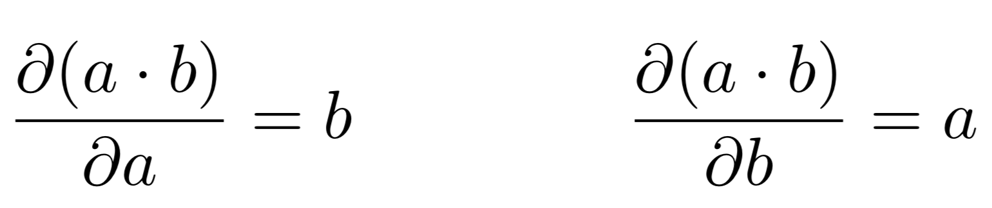
Gradient backpropagation in a logistic regressor
Product: Switches gradient weight values.
w₁
dy/dw₁
-0,2
x
x₁
0,2
1
0.73
ŷ
dy/dx₁
0,4
+
+
σ
0,2
0,2
dŷ/dŷ=1
w₂
dy/dw₂
-0,4
x
0,2
x₂
dy/dx₂
-0,6
b
Backward pass
dy/db
0,2
Example extracted from Andrej Karpathy’s notes for CS231n from Stanford University.

Slide 34
Gradient backpropagation in a logistic regressor
Normally, we will be interested only on the weights (w_{i}) and biases (b), not the inputs (x_{i}). The weights are the parameters to learn in our models.
w₁
dy/dw₁
-0,2
x
x₁
0,2
1
0.73
ŷ
dy/dx₁
0,4
+
+
σ
0,2
0,2
dŷ/dŷ=1
w₂
dy/dw₂
-0,4
x
0,2
x₂
dy/dx₂
-0,6
b
Backward pass
dy/db
0,2
Example extracted from Andrej Karpathy’s notes for CS231n from Stanford University.

Slide 35




(bonus) Gradients weights for MAX & SPLIT
Max: Routes the gradient only to the higher input branch (not sensitive to the lower branches).
0,2
max
0,2
0
Split: Branches that split in the forward pass and merge in the backward pass, add gradients
+

Slide 36
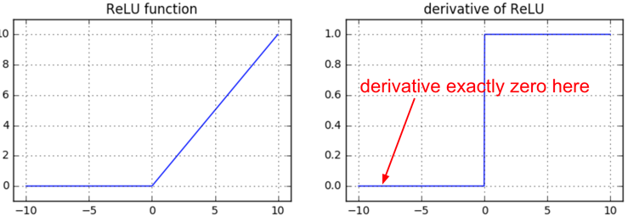
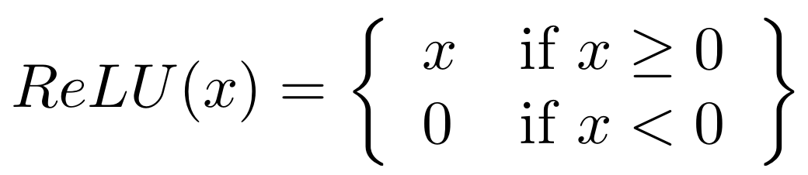
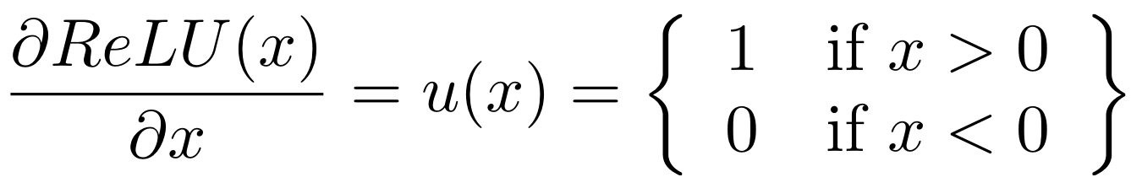
(bonus) Gradients weights for MAX & SPLIT
Figures: Andrej Karpathy

Slide 37
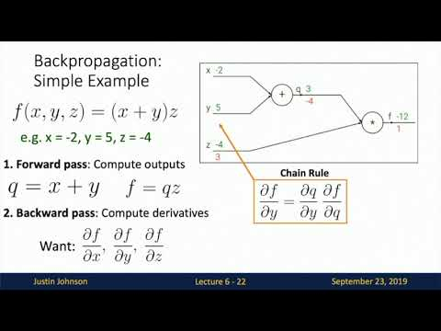
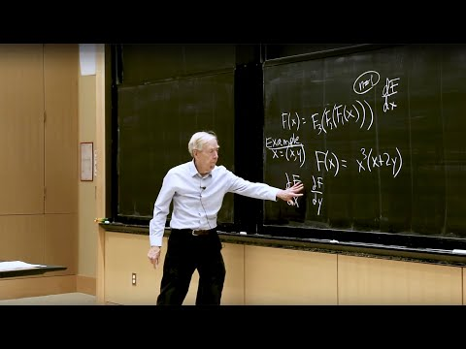
Learn more
Gilbert Strang, “27. Backpropagation: Find Partial Derivatives”. MIT 18.065 (2018)
Justin Johnson, “Backpropagation”.
Deep Learning for Computer Vision.
University of Michigan (2020)
Notes:
Eliminar aquest recordatoei i posar l’exemple de càlcul de funció de pèrdues del capítol d’optimització per motivar l’objectiu.

Slide 38
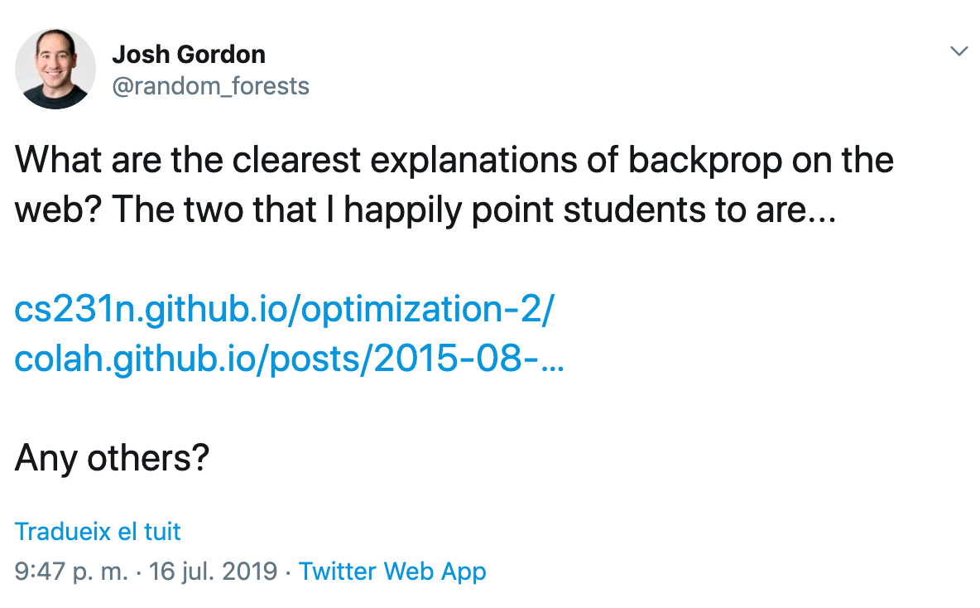
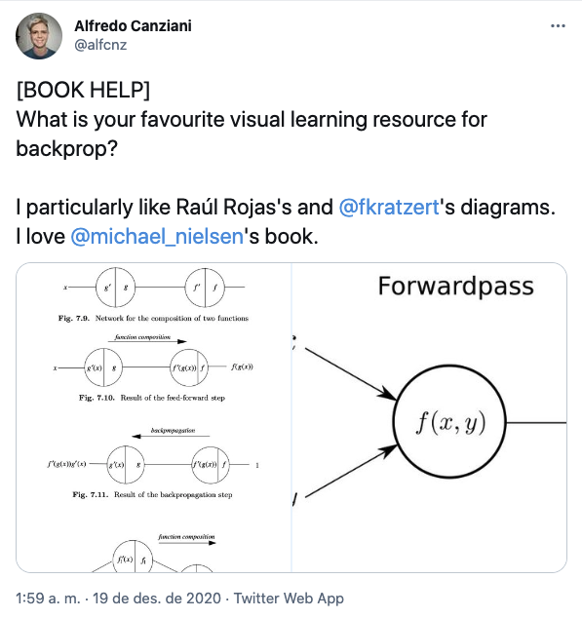
Learn more
READ
Chris Olah, “Calculus on Computational Graphs: Backpropagation” (2015).
Andrej Karpathy,, “Yes, you should understand backprop” (2016), and his “course notes at Stanford University CS231n.
TWITTER THREADS
Notes:
Eliminar aquest recordatoei i posr l’exemple de càlcul de funció de pèrdues del capítol d’optimització per motivar l’objectiu.

Slide 39

Learn more
Creative Commons, “Yoshua Bengio Extra Footage 1: Brainstorm with students” (2018)
Notes:
Eliminar aquest recordatoei i posr l’exemple de càlcul de funció de pèrdues del capítol d’optimització per motivar l’objectiu.

Slide 40


